Slide 1
Database Management System
Lecture # 7-8

Slide 2





Example: University Database
External Schema (View 1 ):
External Schema (View 2):
Course_info(cid:string,cname:string)
student_info(cid:string, name:string)
Students(sid: string
name: string, login: string, age: integer)
Courses(cid: string,
cname:string,
credits:integer)
Enrolled(Eid:string,
cid:string, grade:string)
Relations stored as unordered files.
Index on first column of Students.
Conceptual schema:
Physical schema:

Slide 3


Example: Employee database
External view 1 (C++)
DCL 1 EMPP,
2 EMP# CHAR(6)
2 SAL FIXEDBIN(31)
External view 2 (COBOL)
01 EMPC.
02 EMPNO PIC X(6).
02 DEPTNO PIC X(4).
Conceptual
EMPLOYEE
EMPLOYEE_NUMBER CHARACTER(6)
DEPARTMENT_NUMBER CHARACTER(6)
SALARY DECIMAL(5)
Internal STORED_EMP BYTES=20
PREFIX EMP# DEPT# PAY
BYTE=6 , OFFSET=0
BYTE=6, OFFSET=6, INDEX=EMPX BYTES=4, OFFSET=12
BYTES= 4, ALIGN= FULLWORD,OFFSET=16

Slide 4





Three Levels of Architecture
Syntax Example:
External view 1 External view 2
E_no | F_name | L_name | Age | Salary
Empl_No | L_name | B_no
Conceptual level
Empl_No | F_name | L_name | DOB | Salary | Branch_No
struct EMPLOYEE { int Empl_No;
int Branch_No;
char F_name [15];
char L_name [15];
struct date Date_of_Birth; float Salary;
struct EMPLOYEE *next;
Internal level
//pointer to next employee record
}; index Empl_No; index Branch_No; //define indexes for employees

Slide 5
Advantages Database Schema
You can manage data independent of the physical storage
Faster Migration to new graphical environments
DBMS Architecture allows you to make changes on the presentation level without affecting the other two layers
As each tier is separate, it is possible to use different sets of developers
It is more secure as the client doesn't have direct access to the database business logic
In case of the failure of the one-tier no data loss as you are always secure by accessing the other tier

Slide 6
Disadvantages Database Schema
Complete DB Schema is a complex structure which is difficult to understand for every one
Difficult to set up and maintain
The physical separation of the tiers can affect the performance of the Database

Slide 7
Three Level Architecture Objectives
Each user should be able to access the same data but have a different customize view of the data.
User should not have to deal directly with physical database storage detail.
The DBA should be able to change the database storage structure without affecting the users views.

Slide 8
Three Level Architecture Objectives
The internal structure of the database should be unaffected by changes to the physical aspects of storage.
The DBA should be able to change the conceptual structure of the database without affecting all users.

Slide 9
Data Independence
Data independence is the capacity to change the schema at one level without having to change the schema at the next higher level
There are two kinds:
Logical data independence
Physical data independence

Slide 10
Data Independence
Logical data independence
The ability to modify the conceptual scheme without causing application programs to be rewritten.
The change would be absorbed by the mapping between the external and conceptual levels.
Examples
Adding a new file/index etc.
Adding a new field in a file
Changing type/size
Deleting an attribute

Slide 11
Data Independence
Physical data independence
The ability to modify the internal scheme without having to change the conceptual or external schemas.
Modifications at this level are usually to improve performance.
Example
Changing file organization
Index implementation, hash, tree etc.
Changing storage medium

Slide 12
Database Languages
Data Definition Language (DDL):
Used to define schemas.
Data Manipulation Language (DML):
Used to retrieve, insert, delete, and modify data.
Structured Query Language (SQL):
A comprehensive language that combines both DDL and DML.

Slide 13
SQL Commands
Structured Query Language(SQL) as we all know is the database language by the use of which we can perform certain operations on the existing database and also we can use this language to create a database.
SQL uses certain commands like Create, Drop, Insert etc. to carry out the required tasks.
These SQL commands are mainly categorized into four/five categories

Slide 14
SQL Commands
DDL – Data Definition Language
DQl – Data Query Language
DML – Data Manipulation Language
DCL – Data Control Language
TCL(transaction Control Language)

Slide 15
SQL Commands
DDL (Data Definition Language) : DDL or Data Definition Language actually consists of the SQL commands that can be used to define the database schema.
It simply deals with descriptions of the database schema and is used to create and modify the structure of database objects in the database.

Slide 16
SQL Commands
Examples of DDL commands:
CREATE – is used to create the database or its objects (like table, index, function, views, store procedure and triggers).
DROP – is used to delete objects from the database.
ALTER-is used to alter the structure of the database.
TRUNCATE–is used to remove all records from a table, including all spaces allocated for the records are removed.
COMMENT –is used to add comments to the data dictionary.
RENAME –is used to rename an object existing in the database.

Slide 17
SQL Commands
DQL (Data Query Language) :
DML statements are used for performing queries on the data within schema objects. The purpose of DQL Command is to get some schema relation based on the query passed to it.
Example of DQL:
SELECT – is used to retrieve data from the a database.

Slide 18
SQL Commands
DML(Data Manipulation Language) : The SQL commands that deals with the manipulation of data present in the database belong to DML or Data Manipulation Language and this includes most of the SQL statements.
Examples of DML:
INSERT – is used to insert data into a table.
UPDATE – is used to update existing data within a table.
DELETE – is used to delete records from a database table.

Slide 19
SQL Commands
DCL(Data Control Language) : DCL includes commands such as GRANT and REVOKE which mainly deals with the rights, permissions and other controls of the database system.
Examples of DCL commands:
GRANT-gives user’s access privileges to database.
REVOKE-withdraw user’s access privileges given by using the GRANT command.

Slide 20
SQL Commands
TCL(transaction Control Language) : TCL commands deals with the transaction within the database.
COMMIT - The COMMIT command is the transactional command used to save changes invoked by a transaction to the database.
ROLLBACK - rollback a transaction in case of any error occurs
SAVEPOINT - to rollback the transaction making points within groups
SET TRANSACTION - specify characteristics of the transaction

Slide 21
DBMS Component Modules
The figure showed in next slide is divide into two halves.
The top half refers to the various users of the database system
The lower half shows the internals of the DBMS responsible for storage of data and processing of transactions

Slide 22
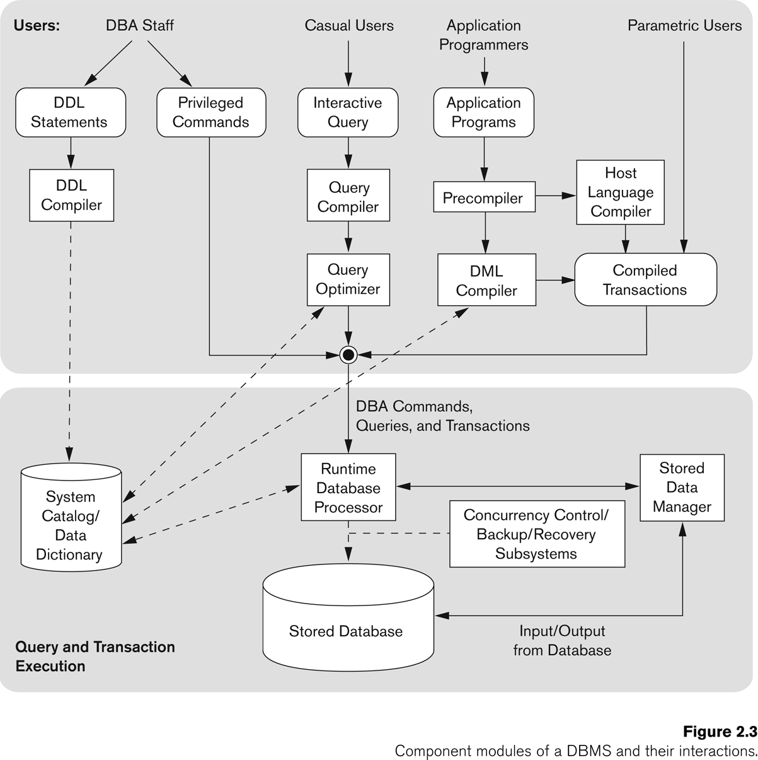
Typical DBMS Component Modules
Users of the database system
Internals of the DBMS

Slide 23
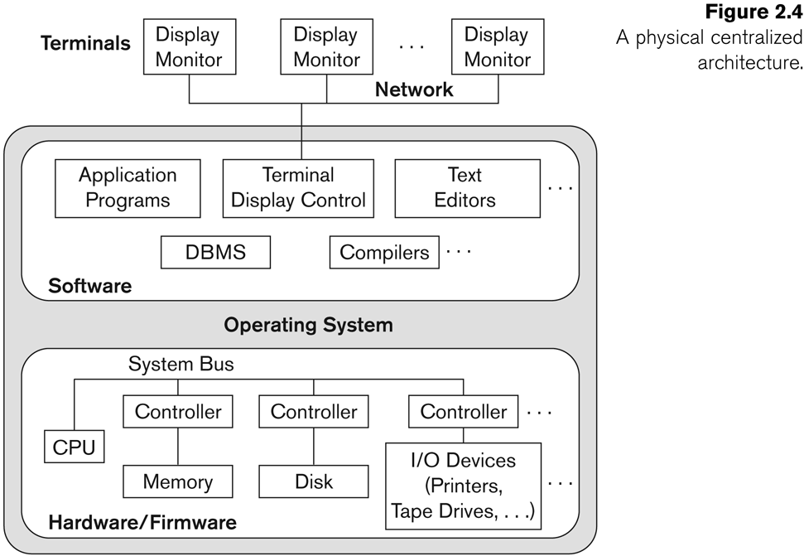
Centralized and Client/Server Architectures for DBMSs
Centralized DBMSs Architecture
All DBMS functionality, application program execution, and user interface processing carried out on one machine

Slide 24
Basic Client/Server Architectures
The client/server architecture was developed to deal with computer environment in which a large number of PCs, workstation, file server…
A client in this framework is typically a user machine that provides user interface capabilities and local processing
A server is a system containing both hardware and software that can provide services to the client machines.

Slide 25
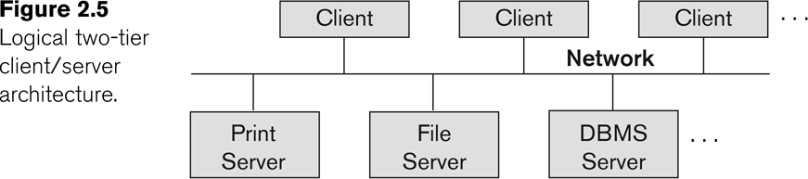
Logical two-tier client server architecture

Slide 26
Two-tier Architecture
This is called two-tire architectures because the software components are distributed over two systems: client and server
The emergence of the Web changed the roles of client and server, leading to the three-tier architecture

Slide 27
Three-tier Architecture
The intermediate layer or middle layer is sometimes called the application server or Web server
Three-tier Architecture Can Enhance Security:
Database server only accessible via middle tier
Clients cannot directly access database server

Slide 28
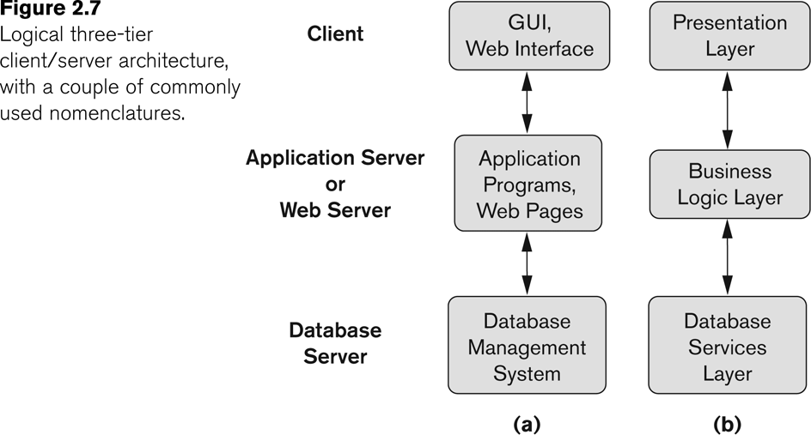
Three-tier Client-Server Architecture

Slide 29
Three-tier architecture
The presentation layer displays information to the user.
The business logic layer handles intermediate rules and constrains before data is passed up to the user or down to the DBMS
If the bottom layer is split into two layers (a web server and a database server), then it is a 4-tire architecture (possible to the n-tier)

Slide 30
Entity Relationship Model

Slide 31
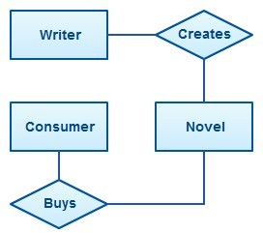
Entity Relationship Model
•
An Entity Relationship Diagram (ERD) is a visual
representation of different data using conventions that
describe how these data are related to each other.
For example, the elements writer, novel, and consumer may be described using ER diagrams this way:
•
The elements inside rectangles are called entities while the items inside diamonds denote the relationships between entities.

Slide 32
Entity
•
An entity can be a real-world object, either animate or inanimate, that can be easily identifiable.
For example, in a school database, students, teachers, classes, and courses offered can be considered as entities.
All these entities have some attributes or properties that give them their identity.
An entity set is a collection of similar types of entities.
An entity set may contain entities with attribute sharing similar values.
For example,
a Students set may contain all the students of a school;
likewise a Teachers set may contain all the teachers of a school from all faculties. Entity sets need not be disjoint.
•

Slide 33
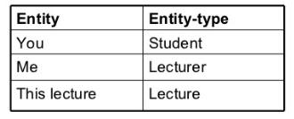
Entity & Entity Type
The entity type is a collection of the entity having similar attributes.
In the Student table (RollNo, Name, Age, Mobile), we have each row as an entity and they are having common attributes i.e each row has its own value for attributes RollNo, Name, Age and Mobile.
So, we can define the above STUDENT table as an entity type because it is a collection of entities having the same attributes. Few examples are

Slide 34
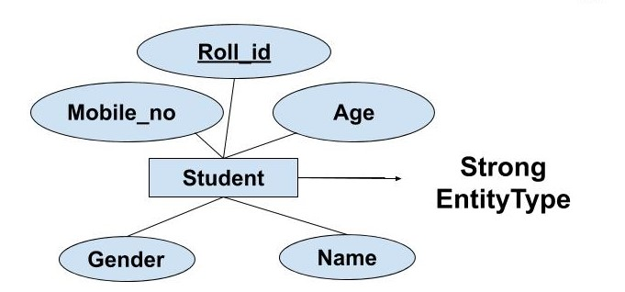
Entity & Entity Type
Types of Entity type (Strong Entity Type, Weak Entity Type)
Strong Entity Type: Strong entity are those entity types which has a key attribute.
The primary key helps in identifying each entity uniquely.
It is represented by a rectangle. In the above example, Roll_no identifies each element of the table uniquely and hence, we can say that STUDENT is a strong entity type.

Slide 35
Entity & Entity Type
Weak Entity Type: Weak entity type doesn't have a key attribute.
It depends upon some other strong entity for its distinct identity. This can be understood with a real-life example.
There can be a room only if building exits. There can be no independent existence of a room.
A weak entity is represented by a double outlined rectangle.
The relationship between a weak entity type and strong entity type is called an identifying relationship and shown with a double outlined diamond instead of a single outlined diamond.

Slide 36
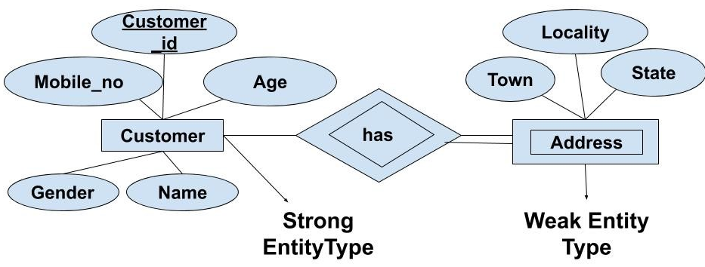
Entity & Entity Type

Slide 37

Entity & Entity Type
•
It uses a foreign key combined with its attributed to form the primary key.
An entity like order item is a good example for this.
– The order item will be meaningless without an order so it depends on the existence of order.
•

Slide 38
Attributes
Entities are represented by means of their properties, called attributes.
All attributes have values.
For example, a student entity may have name, class,
and age as attributes.
There exists a domain or range of values that can be assigned to attributes.
For example, a student's name cannot be a numeric value. It has to be alphabetic. A student's age cannot be negative, etc.

Slide 39
Types of Attributes
•
Simple attribute − Simple attributes are atomic values, which
cannot be divided further. For example, a student's phone number is an atomic value of 10 digits.
•
Composite attribute − Composite attributes are made of more
than one simple attribute. For example, a student's complete name may have first_name and last_name.

Slide 40
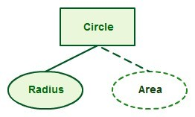
Types of Attributes (contd.,)
Derived attribute − Derived attributes are the attributes that do not exist in the physical database, but their values are derived from other attributes present in the database.
•
•
For example, average_salary in a department should not be saved directly in the database, instead it can be derived.
•
•
For another example, age can be derived from data_of_birth.
For example for a circle the area can be derived from the radius.

Slide 41

Types of Attributes (contd.,)
•
Single-value attribute − Single-value attributes contain single
value. For example − Social_Security_Number.
•
Multi-value attribute − Multi-value attributes may contain more
than one values. For example, a person can have more than one phone number, email_address, etc.
•
For example a teacher entity can have multiple subject values.

Slide 42
About Attributes
These attribute types can come together in a way like −
simple single-valued attributes
simple multi-valued attributes
composite single-valued attributes
composite multi-valued attributes

Slide 44
Entity-Set and Keys
Key is an attribute or collection of attributes that uniquely identifies an entity among entity set.
For example, the roll_number of a student makes him/her identifiable among students.
Super Key − A set of attributes (one or more) that collectively identifies an entity in an entity set.
•
•
•
Candidate Key − A minimal super key is called a candidate key. An entity set may have more than one candidate key.
•
Primary Key − A primary key is one of the candidate keys chosen by the database designer to uniquely identify the entity set.
•

Slide 45

Relationship
•
•
The association among entities is called a relationship.
For example, an employee works_at a department, a student enrolls in a course.
•
Here, Works_at and Enrolls are called relationships.
For example, the entity “carpenter” may be related to the entity “table” by the relationship “builds” or “makes”. Relationships are represented by diamond shapes and are labeled using verbs.
•

Slide 46
Degree of Relationship
The number of participating entities
in a
relationship defines the degree of the relationship.
Binary = degree 2
Ternary = degree 3
n-ary = degree

Slide 47
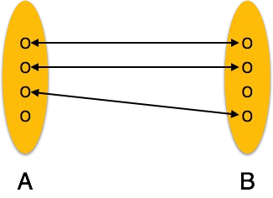
Mapping Cardinalities
Cardinality defines the number of entities in one entity set, which can be associated with the number of entities of other set via relationship set.
•
One-to-one − One entity from entity set A can be associated with at most one entity of entity set B and vice versa.
•

Slide 48
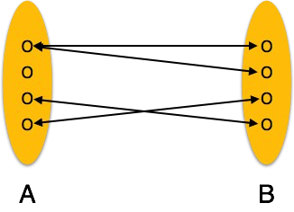
One-to-many − One entity from entity set A can be associated with more than one entities of entity set B however an entity from entity set B, can be associated with at most one entity.

Slide 49
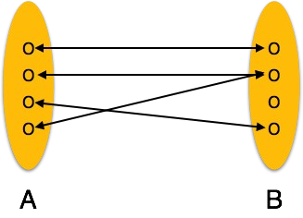
Many-to-one − More than one entities from entity set A can be associated with at most one entity of entity set B, however an entity from entity set B can be associated with more than one entity from entity set A.
•

Slide 50
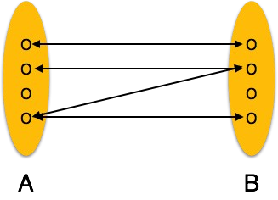
Many-to-many − One entity from A can be associated with more than one entity from B and vice versa.
•

Slide 51
ER Diagram Representation
Let us now learn how the ER Model is represented by means of an ER diagram.
Any object, for example, entities, attributes of an entity, relationship sets, and attributes of relationship sets, can be represented with the help of an ER diagram.
•
•

Slide 52
Entity
Entities are Rectangles represent.
of rectangles.
set they
represented by means
are named with the entity

Slide 53
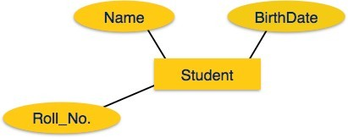
Attributes
Attributes are the properties of entities. Attributes are represented by means of ellipses.
Every ellipse represents one attribute and is directly connected to its entity (rectangle).

Slide 54
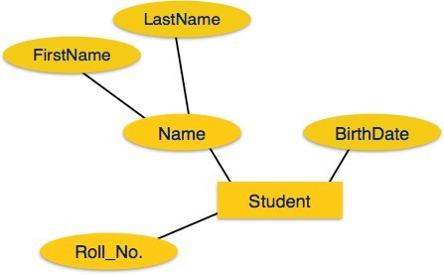
If the attributes are composite, they are further divided in a tree like structure. Every node is then connected to its attribute. That is, composite attributes are represented by ellipses that are connected with an ellipse.
•

Slide 55
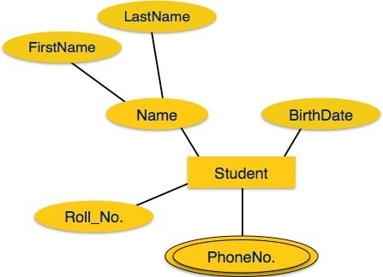
Multivalued attributes are depicted by double ellipse.

Slide 56
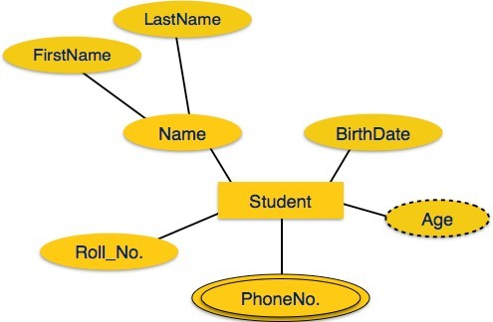
Derived attributes are depicted by dashed ellipse.

Slide 57
Relationship
•
Relationships are represented by diamond-shaped box.
Name of the relationship is written inside the diamond-box.
All the entities (rectangles) participating in a relationship, are connected to it by a line.
•
•
•
Binary Relationship and Cardinality
A relationship where two entities are participating is called a binary relationship. Cardinality is the number of instance of an entity from a relation that can be associated with the relation.
•

Slide 58
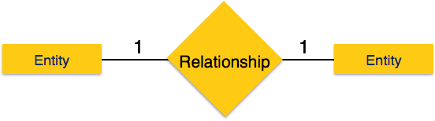
One-to-one − When only one instance of an entity is associated with the relationship, it is marked as '1:1'. The following image reflects that only one instance of each entity should be associated with the relationship. It depicts one-to- one relationship.
•

Slide 59
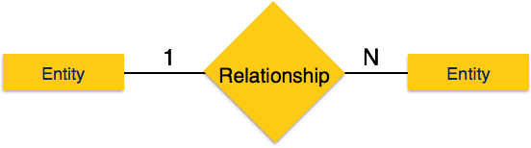
•
One-to-many − When more than one instance of an entity is associated with a relationship, it is marked as '1:N'. The following image reflects that only one instance of entity on the left and more than one instance of an entity on the right can be associated with the relationship. It depicts one-to- many relationship.

Slide 60
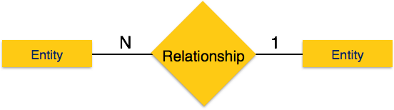
Many-to-one − When more than one instance of entity is associated with the relationship, it is marked as 'N:1'. The following image reflects that more than one instance of an entity on the left and only one instance of an entity on the right can be associated with the relationship. It depicts many-to-one relationship.
•

Slide 61
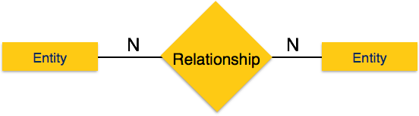
Many-to-many − The following image reflects that more than one instance of an entity on the left and more than one instance of an entity on the right can be associated with the relationship. It depicts many-to-many relationship.
•

Slide 62
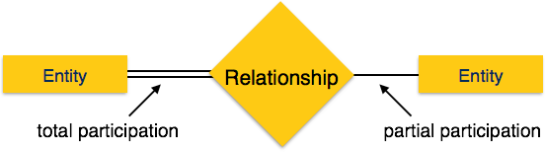
Participation Constraints
Total Participation − Each entity is involved in the relationship. Total participation is represented by double lines.
Partial participation − Not all entities are involved in the relationship. Partial participation is represented by single lines.

Slide 63
Generalization Aggregation
The ER Model has the power of expressing database entities in a conceptual
hierarchical manner.
As the hierarchy goes up, it generalizes the view of entities, and as we go deep in the hierarchy, it gives us the detail of every entity included.
•
•
Going up in this structure is called generalization, where entities are clubbed together to represent a more generalized view.
•
For example, a particular student named Mira can be generalized along with all the students.
•
The entity shall be a student, and further, the student is a person. The reverse is called specialization where a person is a student, and that student is Mira.
•

Slide 64
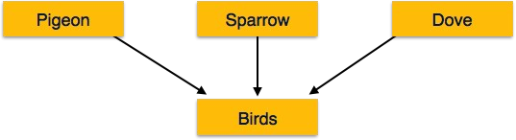
Generalization
•
The process of generalizing entities, where the generalized entities contain
the properties of all the generalized entities, is called generalization.
•
In generalization, a number of entities are brought together into one
generalized entity based on their similar characteristics. For example, pigeon, house sparrow, crow and dove can all be generalized as Birds.

Slide 65
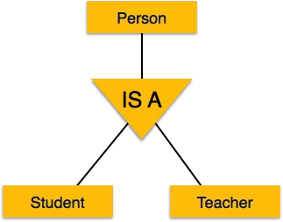
Specialization
•
Specialization is the opposite of generalization. In specialization, a group of entities is divided into sub-groups based on their characteristics.
Take a group ‘Person’ for example. A person has name, date of birth, gender, etc. These properties are common in all persons, human beings. But in a company, persons can be identified as employee, employer, customer, or vendor, based on what role they play in the company.
Similarly, in a school database, persons can be specialized as teacher, student, or a staff, based on what role they play in school as entities.
•

Slide 66
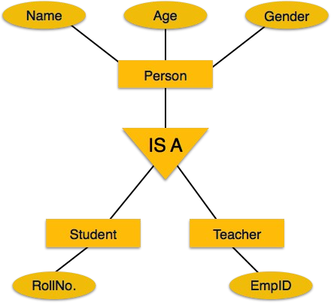
Inheritance
•
We use all the above features of ER- Model in order to create classes of objects in object-oriented programming.
The details of entities are generally hidden from the user; this process known as abstraction.
Inheritance is an important feature of Generalization and Specialization. It allows lower-level entities to inherit the attributes of higher-level entities.
For example, the attributes of a Person class such as name, age, and gender can be inherited by lower-level entities such as Student or Teacher.
•
•
•

Slide 67
ER Diagram Example
•
Suppose you are given the following requirements for a simple database for the National Hockey League (NHL):
•
•
•
•
the NHL has many teams,
each team has a name, a city, a coach, a captain, and a set of players,
each player belongs to only one team,
each player has a name, a position (such as left wing or goalie), a skill level, and a set of injury records,
•
•
a team captain is also a player,
a game is played between two teams (referred to as host_team and guest_team) and has a date (such as May 11th, 1999) and a score (such as 4 to 2).
•
Construct a clean and concise ER diagram for the NHL database.

Slide 68
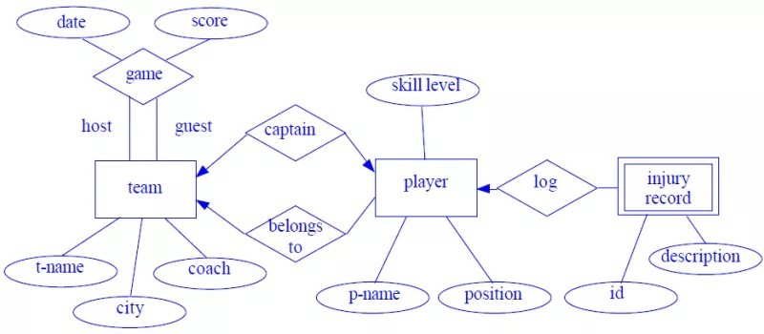

Slide 69
Example 2:
A university registrar’s office maintains data about the following entities:
courses, including number, title, credits, syllabus, and prerequisites;
course offerings, including course number, year, semester, section number, instructor(s), timings, and classroom;
students, including student-id, name, and program;
instructors, including identi‑cation number, name, department, and title.
Further, the enrollment of students in courses and grades awarded to students in each course they are enrolled for must be appropriately modeled. Construct an E-R diagram for the registrar’s of‑ce.Document all assumptions that you make about the mapping constraints.

Slide 70
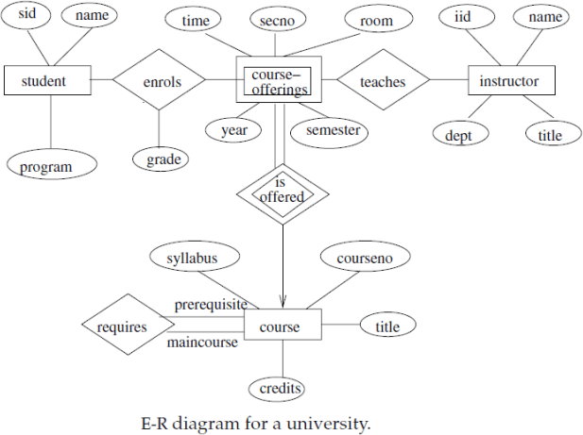

Slide 71
Example 3:
Construct an E-R diagram for a car-insurance company whose customers own one or more cars each. Each car has associated with it zero to any number of recorded accidents.
Construct appropriate tables for the above ER Diagram ?

Slide 72
Car insurance tables:
person (driver-id, name, address)
car (license, year,model)
accident (report-number, date, location)
participated(driver-id, license, report-number, damage-amount)

Slide 73
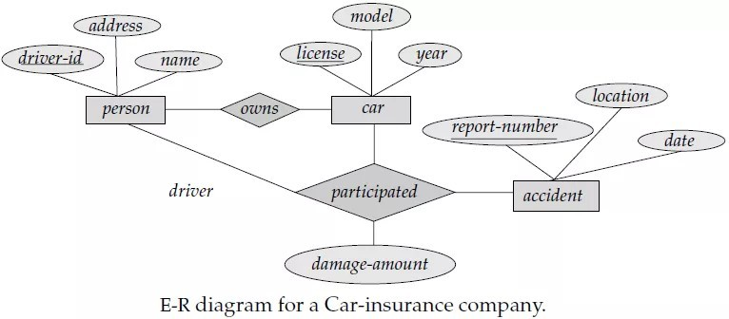

Slide 74
Thanks

